Slide 1

Mediation Ethics and AI:
User Beware
J. Nick Badgerow
Spencer Fane LLP

Slide 2

OVERVIEW
1. AI is a Reality
2. What Is AI?
3. How Do Mediators Use AI?
  Review some available programs
4. Benefits of Using AI in Mediation
5. Risks of Using AI in Mediation
6. Ethical Concerns
7. IBA and JAMS Rules of Ethics
8. For Attorneys: Applicable MRPC

Slide 3

THE POINT:
AI in Mediation can be useful and helpful
AI is not perfect
AI has no soul & no ethics: it is ones and zeroes
So use AI in mediation carefully, thoughtfully
= Use REAL Intelligence when using ARTIFICIAL Intelligence

Slide 4
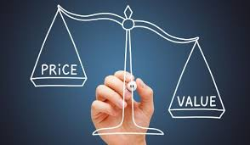
MEDIATION IS VALUABLE
Parties Control Costs
  Much More Cost-Effective
Parties Control Outcome
  Who Can Predict a Jury?
  Agreed Outcome: Both Sides Satisfied
  Jury Verdict: At Least One Side Dissatisfied
Confidential vs. Public Lawsuit
Much More Time-Saving
  Weeks vs. Years
  Discovery
  Depositions
  Experts
  Attorneys

Slide 5

AI is HERE
Use of AI is Increasing
  In All Walks of Life and Professions
AI in Mediation Can Help
  Streamline Processes
  Enhance Accessibility and Efficiency
  Resolve Disputes More Effectively
  Save Time and Reduce Costs
  Navigate Conflicts More Easily
  Make Experience Less Daunting

Slide 6

WHAT THIS TALK IS NOT
Not what programs and apps to use
Not how to use any programs or apps

Slide 7

HOW DO MEDIATORS USE AI –
WHAT PROGRAMS?
MODRIA
Analyze Case
Suggest Solutions
Monitor Case Progress
Communicate with Parties

Slide 8

MATTERHORN
Data Analytics
Manage Case
Communicate with Parties
Draft Agreements
Not for Complex Cases

Slide 9

BOT MEDIATION
AI Powered Avatars
Analyze Case Data
24/7 On Demand Mediation

Slide 10

THEMEDIATOR.AI
Common, Every-Day Disputes
Impartial, Objective Analysis
Suggests Potential Resolutions
Apps for Task Automation

Slide 11

SONIX
Listens
Transcribes Audio & Video
Documents Session

Slide 12


CALENDARHERO & CALENDLY
CalendarHero
Meeting Assistant
Coordinates Meetings
Team Scheduling
Complex
Calendly
Integrations
Notifications
Video Conference Tools
Simpler

Slide 13

OTTER.AI
Meeting Assistant
Transcribes & Summarizes Sessions – Real Time

Slide 14

SMARTSETTLE
Negotiation Algorithms
Facilitate Communication
Suggests Optimal Solutions to Both Sides
Reduces Time
User-Friendly

Slide 15

JURIS TECHNOLOGIES
Dispute Analytics
Analyzes Historical Data: Predict Outcomes
Suggest Resolutions
Intuitive Interfaces

Slide 16

STRIKINGLY
Create Websites
Templates
Integrate Payment Solutions

Slide 17




MANY OTHER PROGRAMS
ADR Notable: case management, scheduling, billing, document generation, and a patented noteboard for organizing notes and proposals.
Immediation: Online dispute resolution system, for managing video sessions, drafting agreements, and invoicing.
FourthParty: Practice management platform - streamlines scheduling, client communication, and billing.
NextLevel Mediation: Help mediators and clients analyze case factors, visualize negotiation strategies, and facilitate data-driven decision-making.

Slide 18
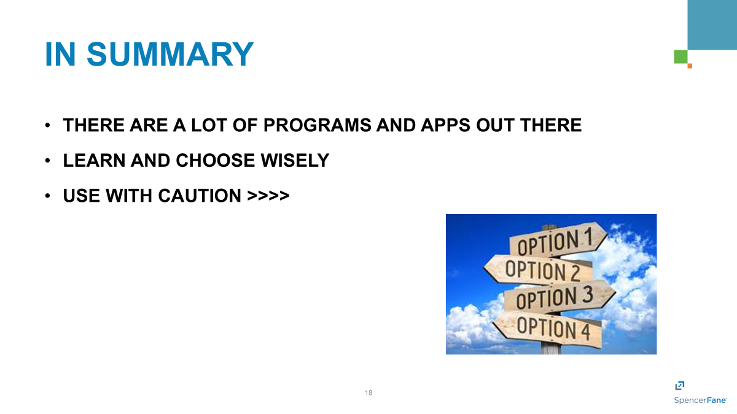

Slide 19

BENEFITS OF AI to MEDIATION
Sift and Analyze Large Volumes of Data
  Search, compare, summarize, give insights
Pose Questions
  Compare to Your Lists – Missed Anything?
Avoid Subjective Factors
Propose Settlements Based on Predefined Rules and Historical Case Data

Slide 20

BENEFITS OF AI to MEDIATION
Predictive Analytics: Machine Learning to Predict Case Outcomes Based on Past Rulings and Agreements
Natural Language Processing (NLP): Chatbots Interpret Inputs and Propose Solutions
Emotional Intelligence (EI): Analyze Participants’ Emotional Cues Through Speech and Facial Recognition Technologies.
  = Mediators Can Tailor Approach to Defuse Tensions and Build Rapport More Effectively

Slide 21
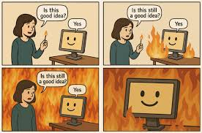
RISKS OF AI to MEDIATION
AI Wants to be Helpful
“Engagement Optimization”

Slide 22
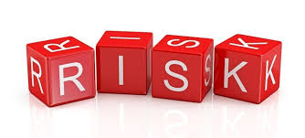
RISKS OF AI to MEDIATION
Introduces Errors Into the Process
  Hallucinations
Cannot Deal With Emotions
  Anger, Frustration, Fear
Reads and Expands on Bias
May Add Confidential Information to World-Wide Database

Slide 23

ETHICAL CONCERNS
1. Algorithmic Bias and Fairness
  Biases May Be Embedded in the Data
  Can Lead to Unfair Outcomes
  May Favor Certain Parties Over Others
  Studies Show Some Legal Programs Disadvantage Minority Groups
  SO: Watch AI Output for Potential Bias

Slide 24
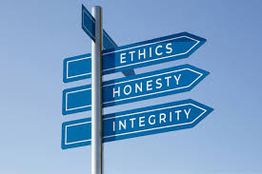
ETHICAL CONCERNS
2. Role of Human Judgment
  AI Lacks Ability to Interpret Emotions, Cultural Nuances, and Unique Human Circumstances
  SO: Use AI as a Decision-Support Tool Rather than a Decision-Maker
  Use Human Ability to Read Cues

Slide 25

ETHICAL CONCERNS
3. Data Privacy and Security
  Input Sensitive Data
    Financial Details
    Personal Disputes
    Legal Information
  SO: End-to-End Encryption For All ODR Communications
    Allow Users to Control How Their Data is Stored and Used
    Check AI Agreements on How Data is Used/Disclosed

Slide 26

ETHICAL CONCERNS
4. Transparency and Explainability
  AI Does Not Always Explain its Recommendations
  Mediator Must Be Transparent About How Decisions Are Made
  Party Must Understand Why a Resolution Was Suggested
  They May Feel the Process Was Unfair – Even if the Outcome Was Reasonable
  SO: Require AI Models to Provide Clear, Explainable Reasoning for Their Decisions
  Explain Reasoning to Parties

Slide 27

INTERNATIONAL BAR ASSOCIATION
Foremost Membership Organization For
International Legal Practitioners, Bar Associations And Law Societies
Goal: Contribute To Global Stability And Peace Through The Promotion And Protection Of The Rule Of Law
Born After Formation Of United Nations
80,000 Lawyer Members
190 Bar Associations
170 Countries

Slide 28


INTERNATIONAL BAR ASSOCIATION
“Guidelines on the Use of Artificial Intelligence in Mediation”
Outlines Risks and Benefits
Safeguards for the use of Artificial Intelligence
Draft Form Contract with Parties if AI is to be Used

Slide 29
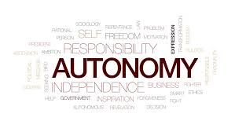
INTERNATIONAL BAR ASSOCIATION –
RULES OF ETHICS FOR MEDIATORS
1. Party Autonomy – Self Determination
  Rule: Parties Must Have Full Control Over The Process
  AI – Produces Errors, Inaccuracies, Bias, Cultural Insensitivity
  Mediator: Assess AI Output To Ensure No Errors, Etc.
  Decide If Reliable/Useable
  If AI Gives Legal Advice = Have A Lawyer Check It

Slide 30

INTERNATIONAL BAR ASSOCIATION –
RULES OF ETHICS FOR MEDIATORS
2. Privacy – Confidentiality
  Rule: Mediation Process and Info Exchanged Are Confidential
  AI: Some AI Adds Info to The Universe of Info Reviewed – Open Source LLM
  Mediator: Ensure AI Programs Do Not Disclose, Compromise or Use Info Provided
  Anonymize Info Provided (= Make Anonymous)
  Review Privacy Rules And Terms Of AI Tools Before Using

Slide 31

INTERNATIONAL BAR ASSOCIATION –
RULES OF ETHICS FOR MEDIATORS
3. Neutrality – Impartiality
  Rule: Mediator Must Be Neutral, Impartial, Independent
  AI: Some Programs Start to Take Sides. Read Bias.
  Mediator: Ensure AI Input Does Not Show Partiality
    Phrase Prompts In Neutral Terms
  Ensure AI Output Does Not Imply Partiality

Slide 32
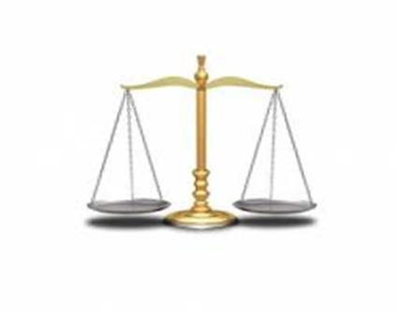
INTERNATIONAL BAR ASSOCIATION –
RULES OF ETHICS FOR MEDIATORS
4. Balanced Process
  Rule: Mediator Must Be Balanced – Give All Participants Equal Opportunity to Participate and Express Views
  AI: Is not typically used, though used more all the time
  Mediator: All Participants Should Be Advised of AI Tools Being Used By Any Participant
  All Participants Should Be Given Full Opportunity to Participate

Slide 33
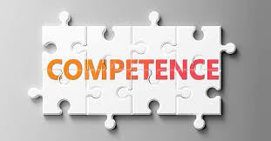
INTERNATIONAL BAR ASSOCIATION –
RULES OF ETHICS FOR MEDIATORS
5. Competence
  Rule: Mediator must be competent to perform
  AI: Is different, unusual, technical
  Mediator: Learn How to Use and Monitor AI
  Review and Consider AI Agreements
  Keep Abreast of Changes and Developments
  = Be Competent to Use AI

Slide 34
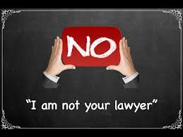
INTERNATIONAL BAR ASSOCIATION –
RULES OF ETHICS FOR MEDIATORS
6. Avoid Legal Advice
  Rule: You are not counsel for either side
  AI: Builds legal analysis into recommendations
  Mediator:
  I Am NOT Your Lawyer
  Advise: Seek Independent Legal Advice

Slide 35


JUDICIAL ARBITRATION AND MEDIATION SERVICES - JAMS
World’s Largest Private Provider Of ADR Services
More Than 21,000 Cases Annually
500 Neutrals
29 Locations
“Mediators Ethics Guidelines”

Slide 36
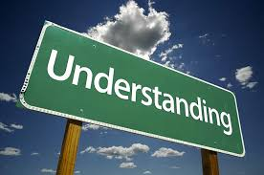
JAMS MEDIATOR ETHICS
1. All Parties Must Understand Process & Mediator’s Role
If Settled, All Parties Understand Terms
Mediator: Explain
  Open, Frank Discussion
  I Am Not A Judge; I Will Not Make A Ruling
  I Am Not Your Lawyer; If Need Advice, Get It
  Explain All Terms Of The Settlement Agreement To Ensure Knowing Consent By All Parties

Slide 37

JAMS MEDIATOR ETHICS
2. Protect The Voluntary Participation Of Each Party
Mediator: Ensure All Parties Agree To Mediate
Even If Court-ordered, No Settlement Unless All Agree
Give All Participants Free Opportunity to Participate

Slide 38
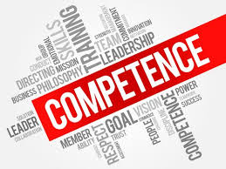
JAMS MEDIATOR ETHICS
3. Mediator Should Be Competent To Mediate The Particular Matter
Mediator: Be Competent To Mediate
Knowledgeable About Subject Matter
Know How To Mediate
Know How To Use The AI
Review All Pre-mediation Statements
Withdraw If Physically Or Mentally Unable To Continue

Slide 39
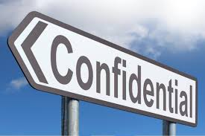
JAMS MEDIATOR ETHICS
4. Maintain The Confidentiality Of The Process
Mediator: All Parties Must Understand It Is Confidential
Assure Parties Mediator Will Maintain Confidentiality
  Unless Required By Court Order
Not Disclose Confidential Information
Not Use Confidential Information For Personal Gain
Keep Notes And Files Private And Confidential

Slide 40
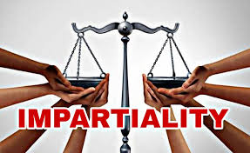
JAMS MEDIATOR ETHICS
5. Conduct The Process Impartially
Mediator: Be Impartial Throughout
Not Appear To Be Partial
Avoid Potential Bias
Provide A Fair Process
Disclose Conflict Of Interest And Decline To Serve If Conflict Casts Doubt On Integrity Of Process
Not Recommend Professionals/Experts/Attorneys
Avoid Gifts During Or After Mediation = Casts Doubt

Slide 41

JAMS MEDIATOR ETHICS
6. Refrain From Providing Legal Advice
Mediator: “I Am Not Your Lawyer”
Not Advise On Legal Issues
(Hard Not To Express Opinions About Outcomes)

Slide 42

JAMS MEDIATOR ETHICS
7. Withdraw Under Certain Circumstances
Mediation To Further Illegal Ends
Lack Of Informed Consent
Mediator Cannot Remain Impartial
Mediator Cannot Continue Due To Mental Or Physical Impairment
Unwaived Conflict Of Interest

Slide 43

WHAT IS A CONFLICT OF INTEREST?
Current/Prior Representation of a Party
Current/Prior Business Relationship with a Party
Prior Mediation for One Party
Close Family Relationship
Major Ownership or Management of a Party
Repugnance/Distaste for a Party or Its Industry/Business

Slide 44
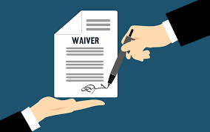
WHAT IS A WAIVER OF CONFLICT?
Describe Situation to all Parties in Full
Describe Risks of Proceeding, i.e.:
  You might come to distrust Mediator or Proceeding
  You might see Mediator’s advice as swayed by the conflict
  You might later regret the Result and blame the conflict
  You are free not to waive and find a Mediator with No Conflict
Obtain Full, Voluntary, Unconditional Consent from all Parties
Preferably in writing, signed

Slide 45
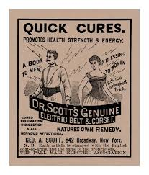
JAMS MEDIATOR ETHICS
8. Avoid Marketing That Is Misleading And Do Not Guarantee Results
Mediator: Truthful Advertising
Do Not Guarantee Results
Do Not Appear To Favor
One Type Of Disputant Or Industry

Slide 46
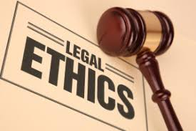
LAWYER ETHICS
Many Mediators Are Lawyers
Lawyers Must Comply With Ethics Rules
Even When Acting As Mediator

Slide 47
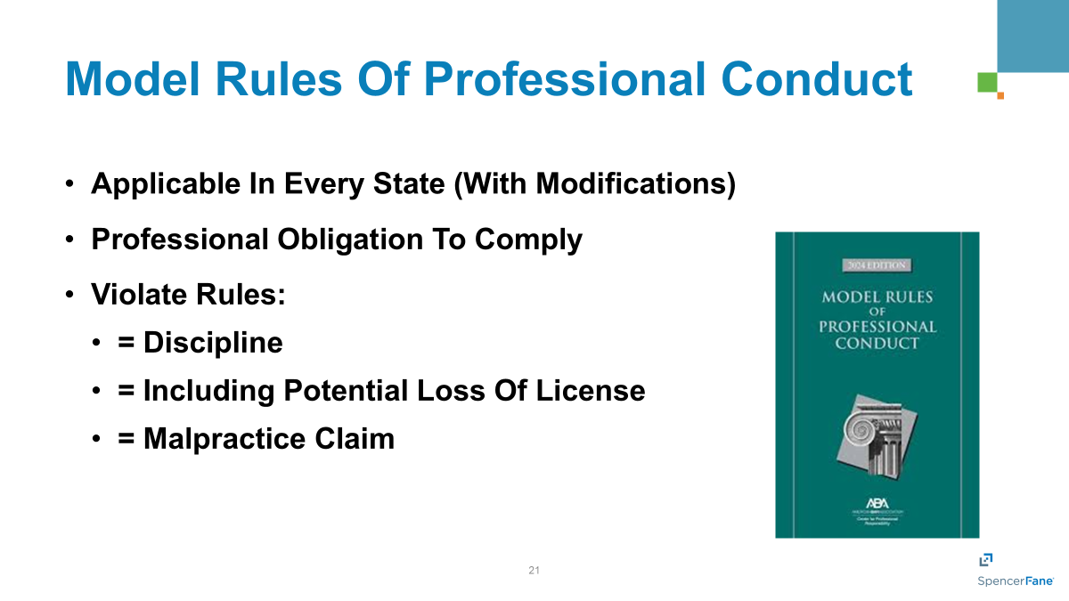

Slide 48
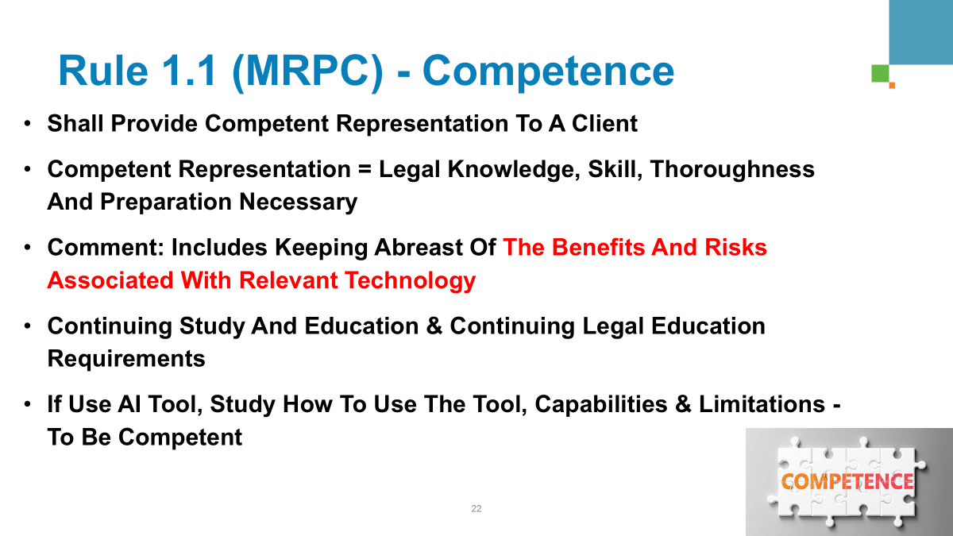

Slide 49
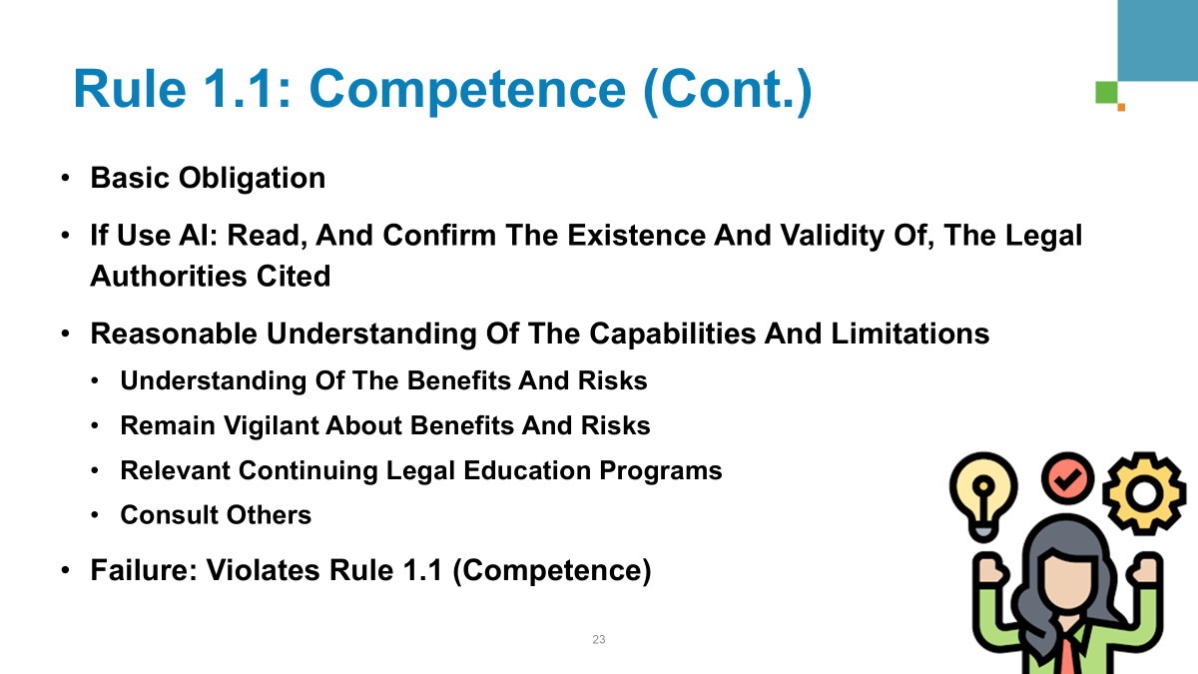

Slide 50
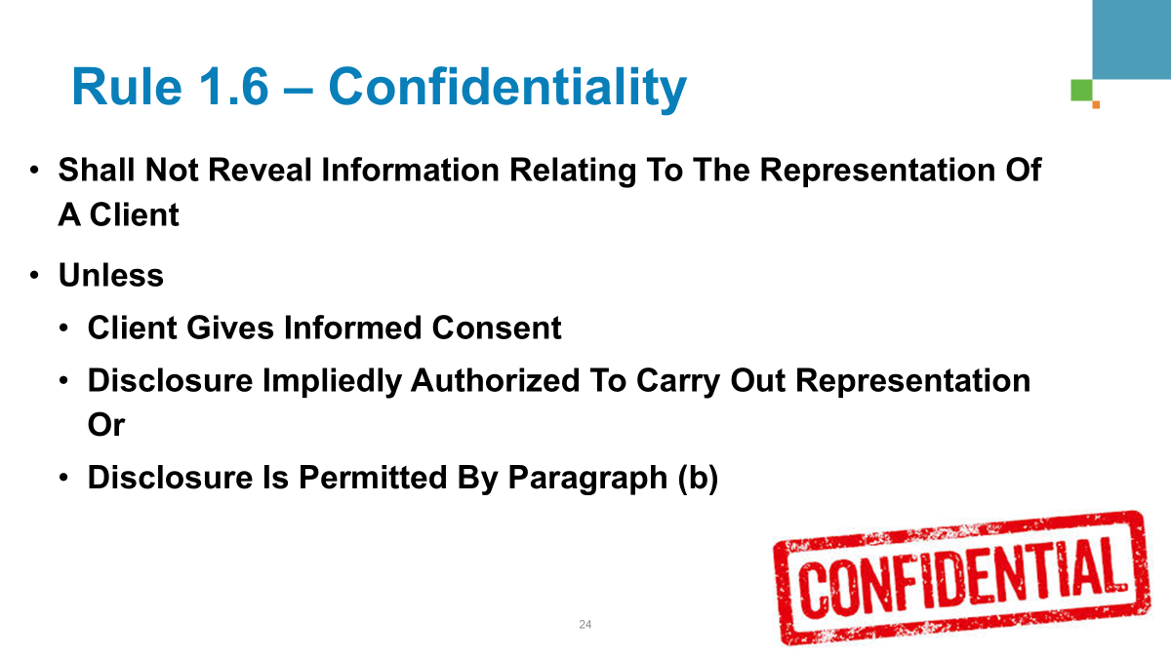

Slide 51
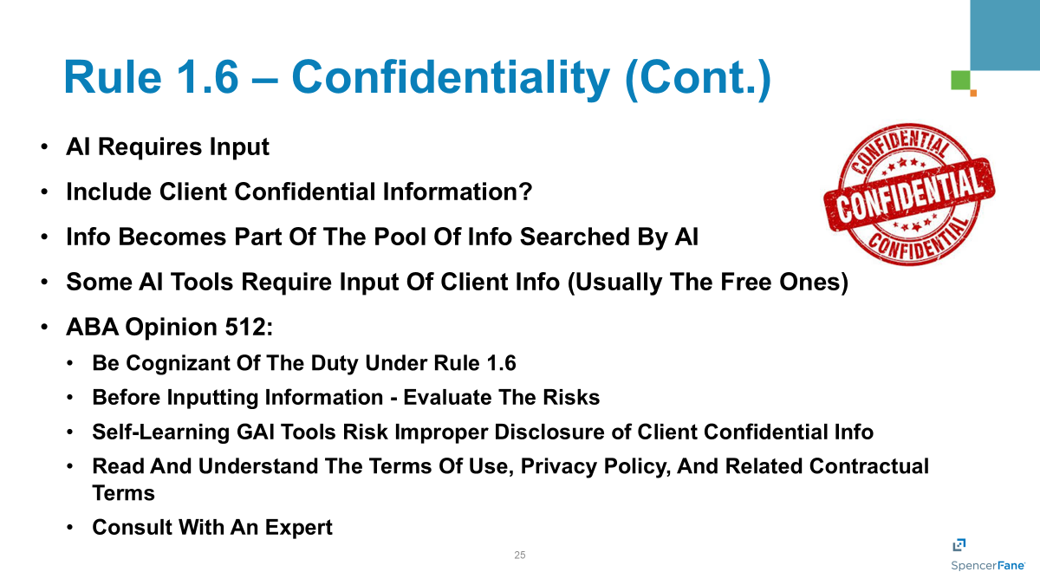

Slide 52

[Rules 1.7 & 1.9 – No Conflicts of Interest]
“Not represent a client” if Concurrent or Former Client Conflict
So, not handle Mediation if Client is a Party to Mediation = Could be Adverse
Otherwise, These Two Rules not really apply
But: Avoid Conflicts of Interest in Mediation – as above
  No Mediation where Prior/Current Client is a Party
  Prior/Current Investment
  Prior/Current Business Deals
  Close Personal Relationship

Slide 53
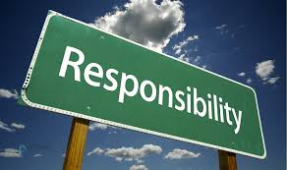
Rule 5.1 – Responsibility for Subordinates
Make sure subordinates (associates, assistants) are aware of Rules
Make sure subordinates comply with Rules
Responsible for subordinates’ violation of Rules
  Orders
  Ratifies
  Knows and Fails to Take Remedial Action

Slide 54

CONCLUSION
AI is taking over
It is inevitable
Better to embrace and learn
But: Be careful
  Autonomy / Self-Determination
  Privacy / Confidentiality
  Neutrality / Impartiality
  Balanced Process
  Competence
  Avoid Legal Advice

Slide 55

CONCLUSION (CONT.)
Attorney Mediators
  Rule 1.1 – Competence
  Rule 1.6 – Confidentiality
  Rule 5.1 – Responsibility for Subordinates
AI is a TOOL
  AI does not have a soul
  AI has no ethics
  AI has no soul
  AI is just ones and zeroes
  Use it, but don’t substitute Artificial Intelligence for HUMAN INTELLIGENCE

Slide 56


Slide 57


Slide 58
