Slide 1
Trauma Informed
Pre-Mediation Coaching
Andrea Keeling, LLM candidate
Dawn E. Kuhlman, MA
M.A.R.C.H. Inc., Executive Director
816-708-2714
dkuhlman@marchmediation.org
©2026 Dawn Kuhlman

Slide 2

MO-wide nonprofit (1997)
Free services to families receiving MO Child support services (IV-D)
  Supervised visitation
  Mediation
  Limited legal services
Serving Kansas! Effective June 1, 2025
  Fee-based services
  $500 2 hrs of mediation
Discussion items in mediation
parenting time
transportation/exchanges
child support/financial needs
payment of arrearage
health care
health or safety of parent and/or children
tax deduction

Slide 3

My Guiding Map

Slide 4
Empowerment & Recognition
Brain/Body
Dysregulation
Mindfulness
Trauma Informed Mediation
Community Resources
Ability to Mediate

Slide 5
Trauma Informed
Operating Framework
“What is wrong with you?”
vs.
“What happened to you?”
Compassionate lens
Curiosity
Suspend judgment
Reframe for less threatening perspective

Slide 6
5 Core Principles of
Trauma Informed Care
Safety: Ensuring physical and emotional safety
Trustworthiness: Maximizing trustworthiness, making tasks clear and maintaining appropriate boundaries
Choice: Prioritizing developmentally appropriate choice and control for children, youth, families and adults
Collaboration: Maximizing collaboration and sharing of power with children, youth, families and adults
Empowerment: Prioritizing child, youth, family and adult empowerment skill-building
Source: Trauma Informed Pathways to the Five Domains of Wellbeing (2016) MO Children’s Division

Slide 7
Empowerment & Recognition
Brain/Body
Dysregulation
Mindfulness
Trauma Informed Mediation
Community Resources
Ability to Mediate

Slide 8
Continuum of Capability
Unable
Able

Slide 9
Demystifying Legal World
What does it mean to demystify?
To demystify something means to make it clear, simple, or easier to understand, especially if it was previously confusing, complicated, or surrounded by mystery or misunderstanding.
For example:
"She worked to demystify the legal process so clients wouldn’t feel intimidated."
"This video aims to demystify mediation by explaining it in everyday terms."
In short, it’s about breaking something down so it’s less intimidating and more accessible.
To demystify - transform from
Confusing to clear
Remove myths - provide answers
Humanize - not a monolithic institution “you people”
Create trust
Shift from interrogation to collaboration
Create empowerment by creating choice - even if court ordered
Remove mystery

Slide 10
Communicate to Connect
Start with what we offer/can provide - rather than what we can’t!
Focus on what moves client to where they need/want to be
What do you need? I’ll see if I can help.
Even if can’t help, connecting them to resources that can.

Slide 11
Empowerment & Recognition
Brain/Body
Dysregulation
Mindfulness
Trauma Informed Mediation
Community Resources
Ability to Mediate

Slide 12

The Matrix

Slide 13
Beyond Mediation
Resources
5 Stage Mediation Process
Stress & Emotion Management
Pre-
Mediation
Coaching
Next Steps-
Mediation Preparation
Communication

Slide 14
Agenda for the Pre-Mediation Coaching session
Understand the mediation process
  5 Stage Mediation Process
Know what to expect and how to prepare
Identify goals and priorities
Learn tools to manage stress and communicate effectively

Slide 15

5 Stage Mediation Model
Opening Monologue
Parties Statements
Defining Problem
Problem-solving and Negotiation
Agreement writing

Slide 16
Beyond Mediation - Legal Resources
**In order for a mediation agreement to be enforced by the court it needs to be drafted properly, filed and approved by the court. May also require court hearing.**
Options:
Your attorney will draft and file paperwork with the court.
Eligible MARCH cases qualify for free limited legal services and will pay filing fees. Uncontested cases only.
Find free or income-based legal services on our website https://www.marchmediation.org/faq-resources
Missouri www.selfrepresent.mo.gov
Kansas https://www.ksd.uscourts.gov/self-represented-litigants

Slide 17



Beyond Mediation - Resources
MARCH Cases may qualify for FREE
Our Family Wizard & Reduced fee Soberlink

Slide 18
Beyond Mediation
Resources
5 Stage Mediation Process
Stress & Emotion Management
Pre-
Mediation
Coaching
Next Steps-
Mediation Preparation
Communication

Slide 19

Empowered in Mediation
Focus on your
Choices
Resources
Skills
Decisions

Slide 20

I have power over my…
Thoughts/beliefs
  Squash ANTS (Automatic Negative Thoughts)
Emotions
Behaviors
  Reacting v. responding

Slide 21
Mindfulness application in mediation
Mindfulness of breath
  Deep breathing
Mindfulness of emotion
  Storm passing
Mindfulness of thoughts
  Automatic Negative Thoughts (ANTS)
Mindfulness of words
Present moment awareness

Slide 22
Mindfulness - Be present
Can’t change past!
Past
Present
Future

Slide 23
Identifying Triggers
Is my response in proportion to the event?
Is my response helpful?
What thoughts, feelings, bodily sensations am I experiencing? If any?
What is this experience associated with in my life? Connections?
Have you asked yourself “Why do I respond this way?”

Slide 24



Let’s Re-Center
Breathe in: Smell the Flower
Exhale: Blow out the candle
“I am safe. I am in control.”

Slide 25
Beyond Mediation
Legal Resources
5 Stage Mediation Process
Stress & Emotion Management
Pre-
Mediation
Coaching
Next Steps-
Mediation Preparation
Communication

Slide 26
Communication
Defensive
Non-Defensive
Focus on weaknesses
Focus on other and what they “should” be doing
Victim mindset
Mindlessly say and do hurtful things
Focus on strengths
Focus on self and things I can control
Empowerment
Mindfulness of words, thoughts, emotions

Slide 27

Recognition of other parent
They are a human
Recognition of their thoughts and feelings
Recognition of their work or progress
Say “Thank you” and other words of recognition

Slide 28

“Cognitive Reappraisal”
- Reframing Techniques
You have to challenge your original interpretation of something!
Is it the ONLY way of seeing the situation?
Are there rational, non-threatening ways of understanding the matter?
Notes:
Asking questions, is a very non-threatening way to challenge ideas.
Have you ever considered that…?
What are some other things that might have contributed to this?
How do you think your behavior may have been interpreted by the other person?
Sometimes people get really upset about trivial matters. Ask - Is it that important? Is it worth being that upset over it? – the idea being “Don’t sweat the small stuff.”
Asking these questions, at least slows the process down and helps them think.

Slide 29
Beyond Mediation
Legal Resources
5 Stage Mediation Process
Stress & Emotion Management
Pre-
Mediation
Coaching
Next Steps-
Mediation Preparation
Communication

Slide 30

Mediation Preparation
Gather needed documents:
Proposed parenting plan or current judgment
Health and Daycare costs
W-2 and/or pay stubs
Court documents
Child Support order (payment amount, arrearage amount, etc)

Slide 31
Pre and Post Coaching Eval
PRE-COACHING SURVEY - Mediation Readiness
Please answer based on how you feel right now. There are no right or wrong answers. 1-5
1. I feel emotionally prepared to participate in mediation.
2. I know what I can do if I start to feel overwhelmed during mediation.
3. I feel safe expressing my needs or concerns in a mediation setting.
4. I feel confident explaining my perspective in mediation.
5. I feel able to listen to the other party, even when it is difficult.
Open-ended
What concerns or questions do you have about mediation right now?

Slide 32
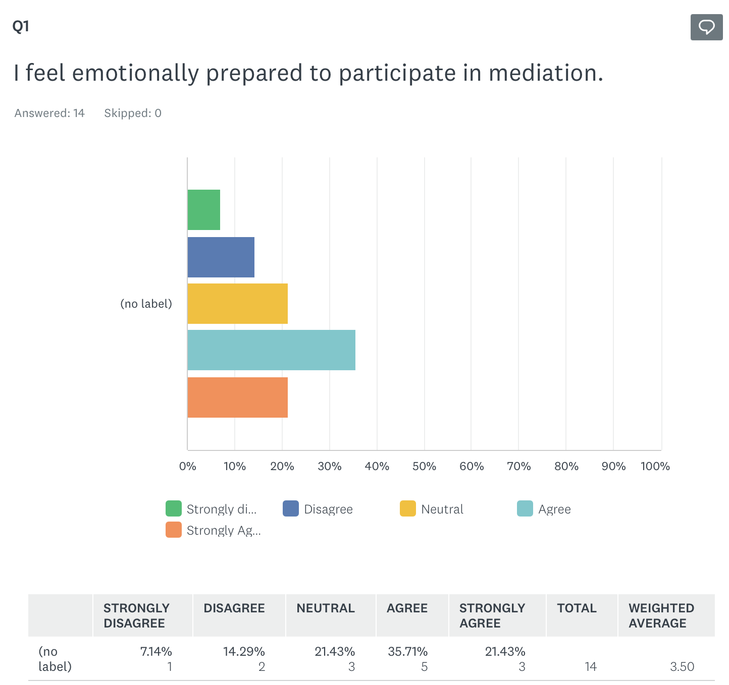
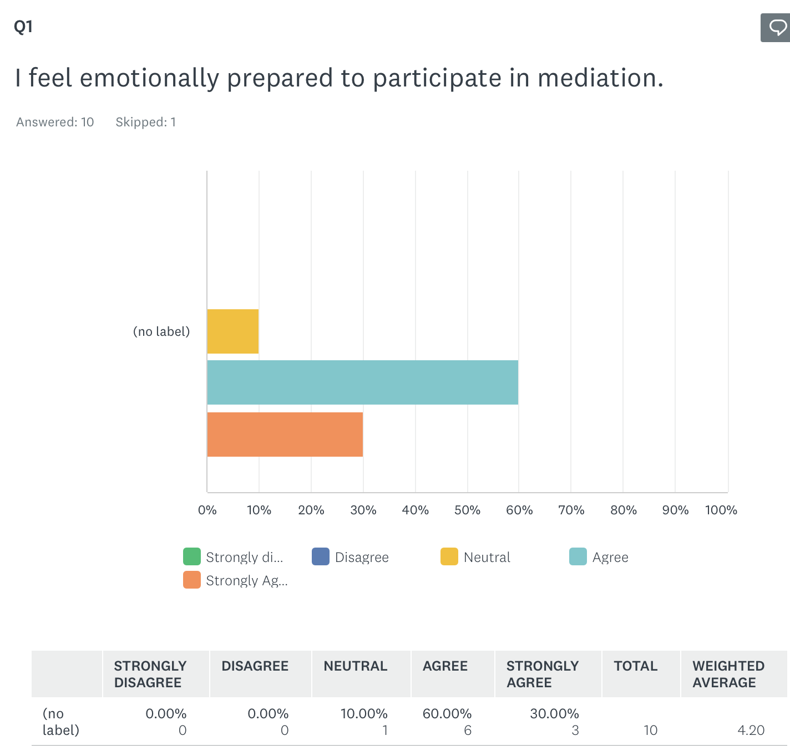
Question 1:

Slide 33
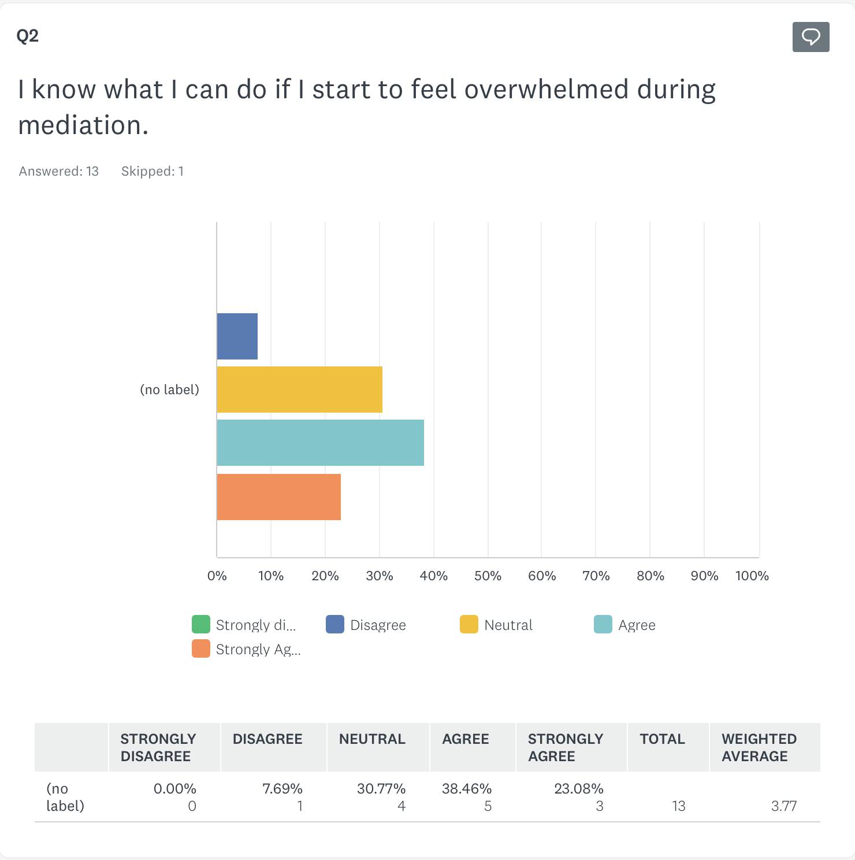
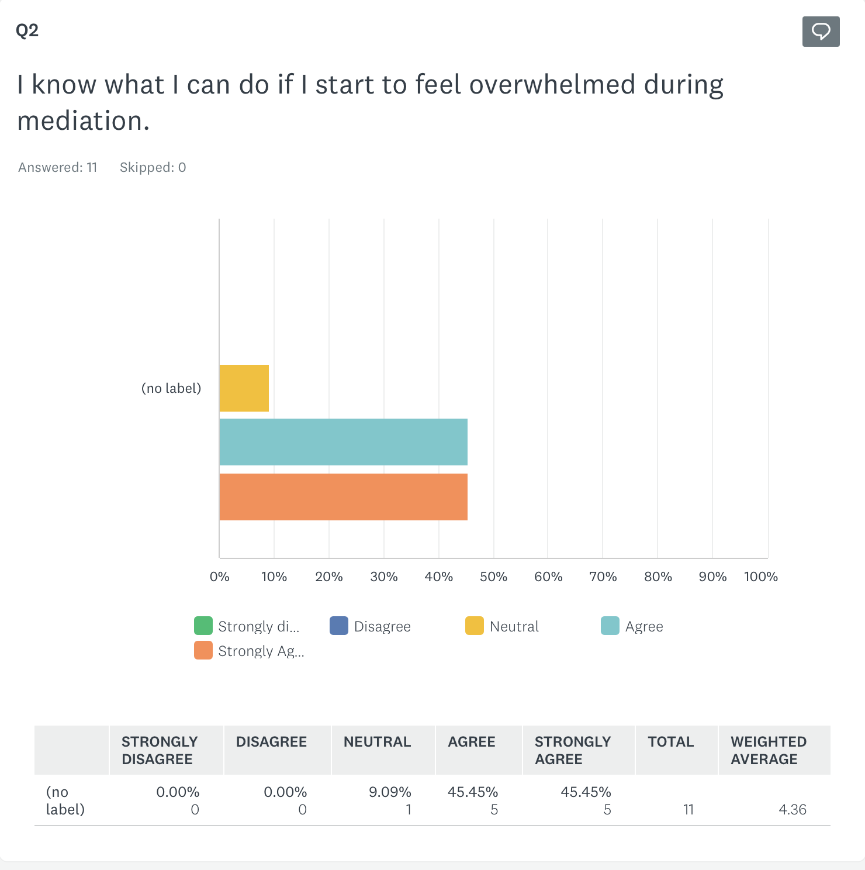
Question 2:

Slide 34
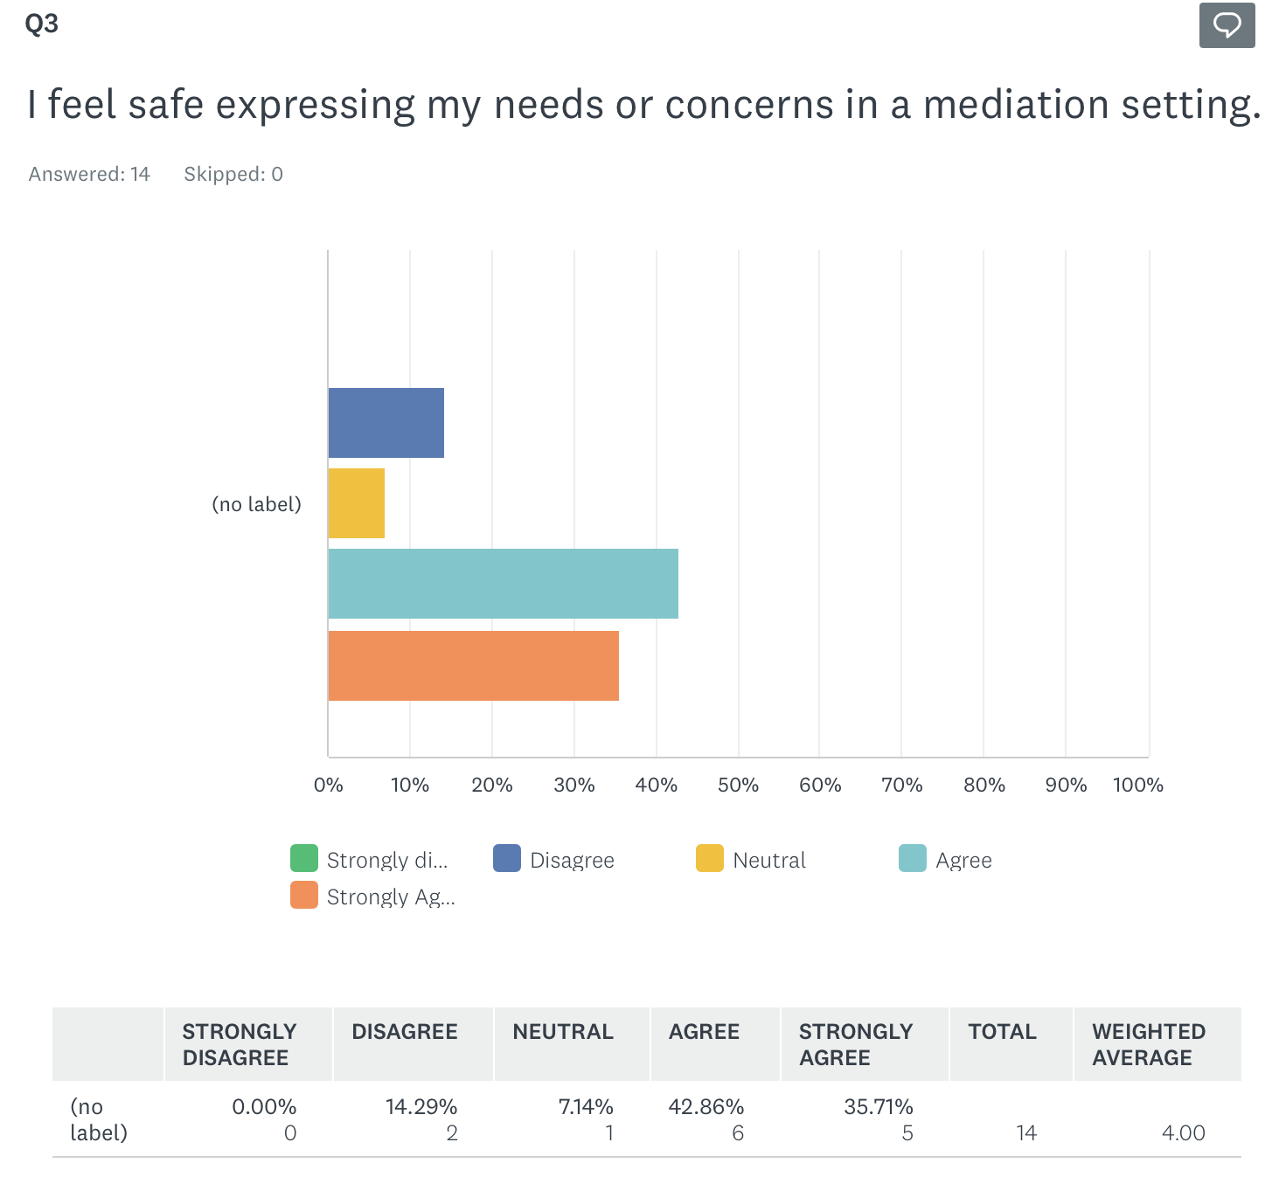
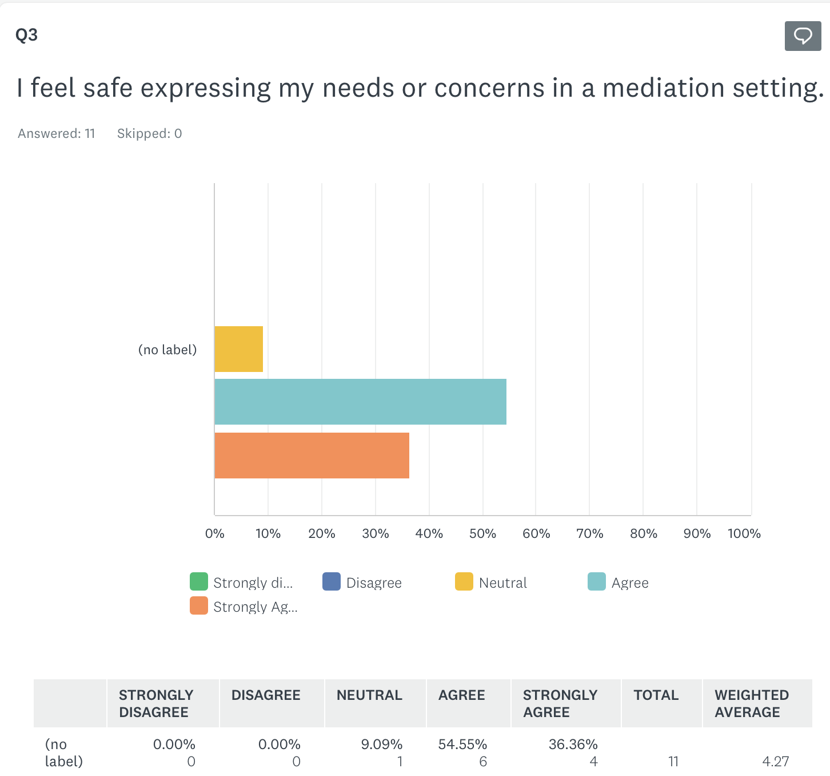
Question 3:

Slide 35
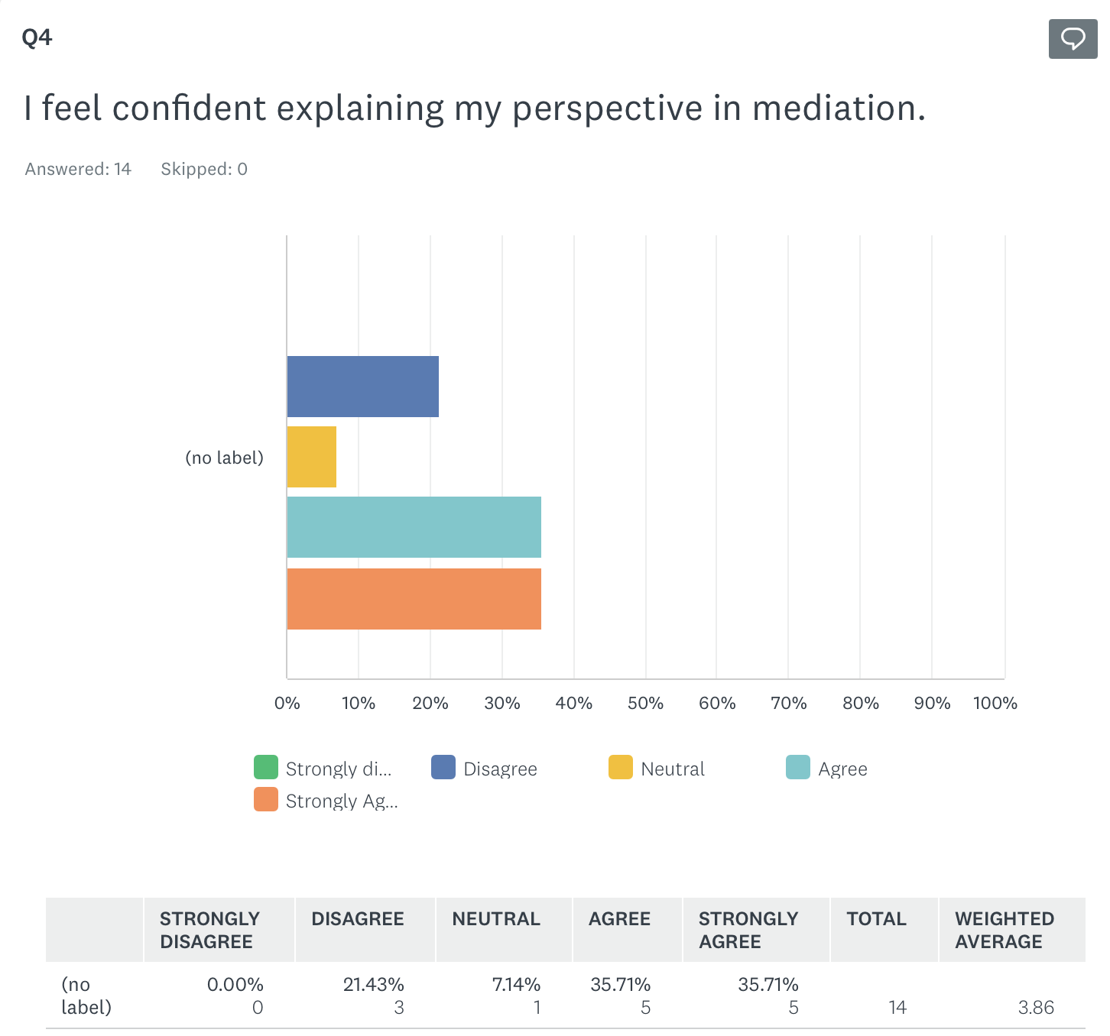
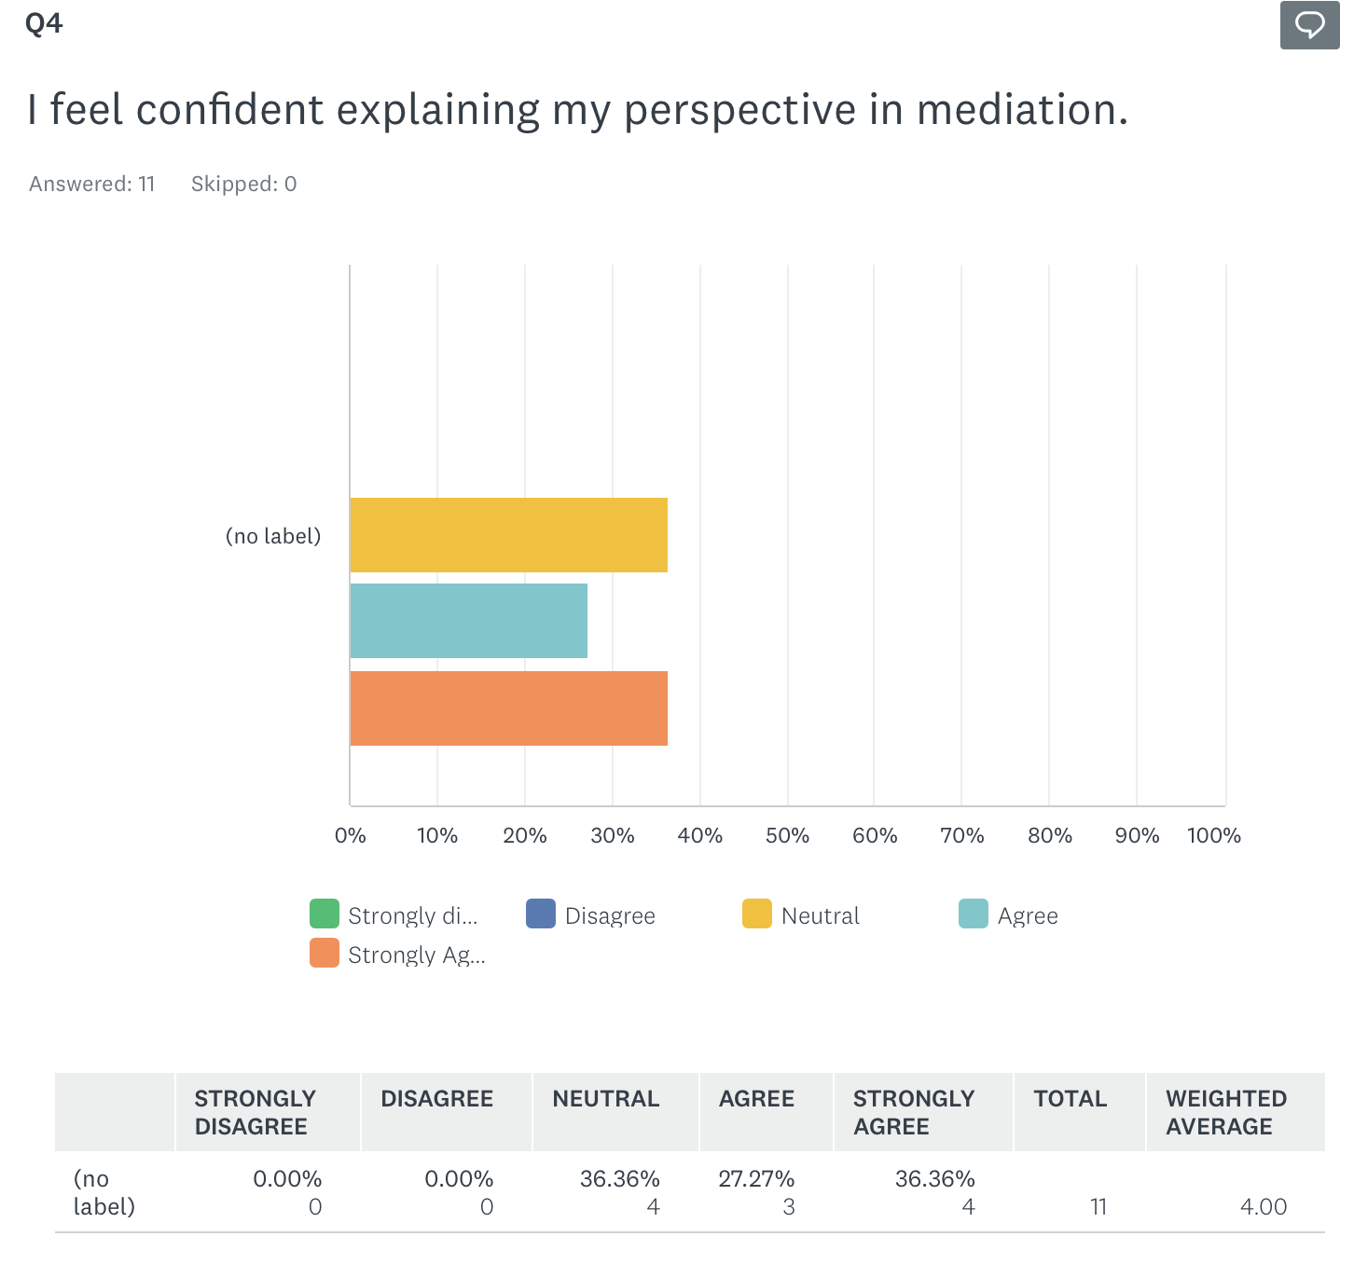
Question 4:

Slide 36
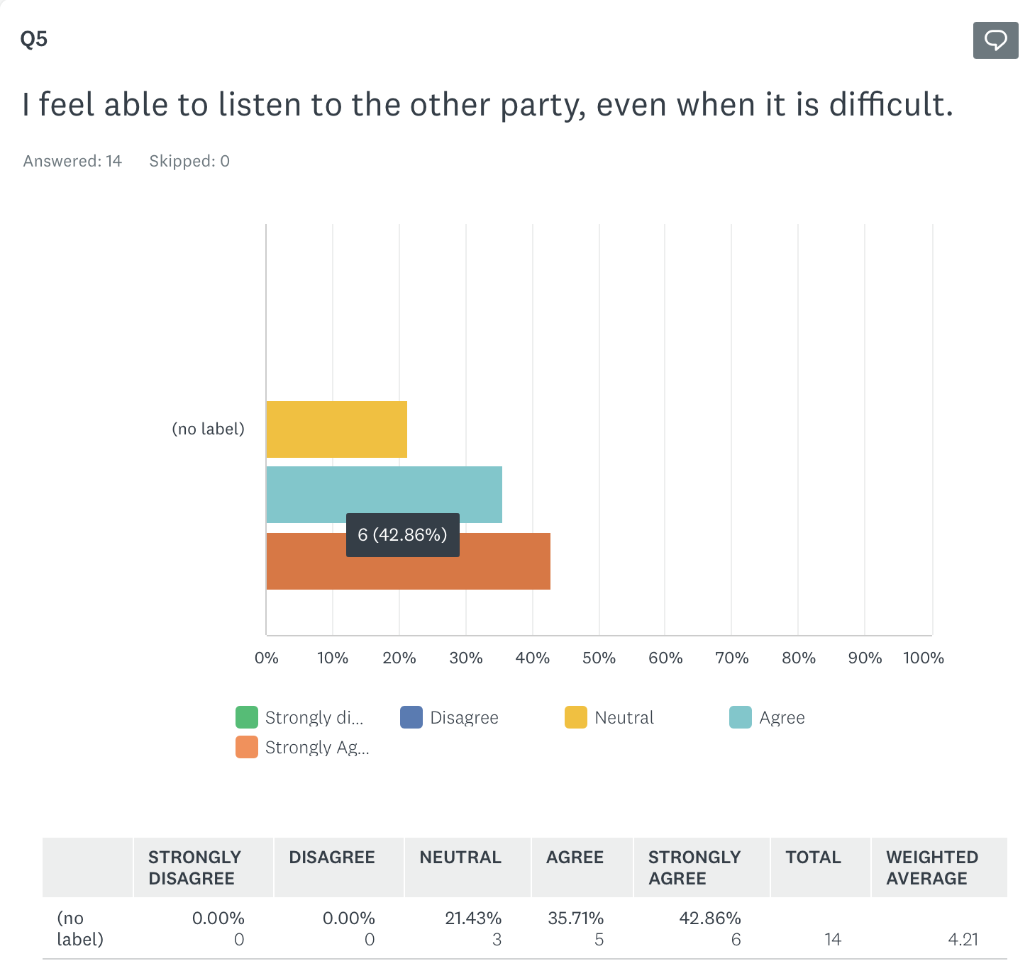
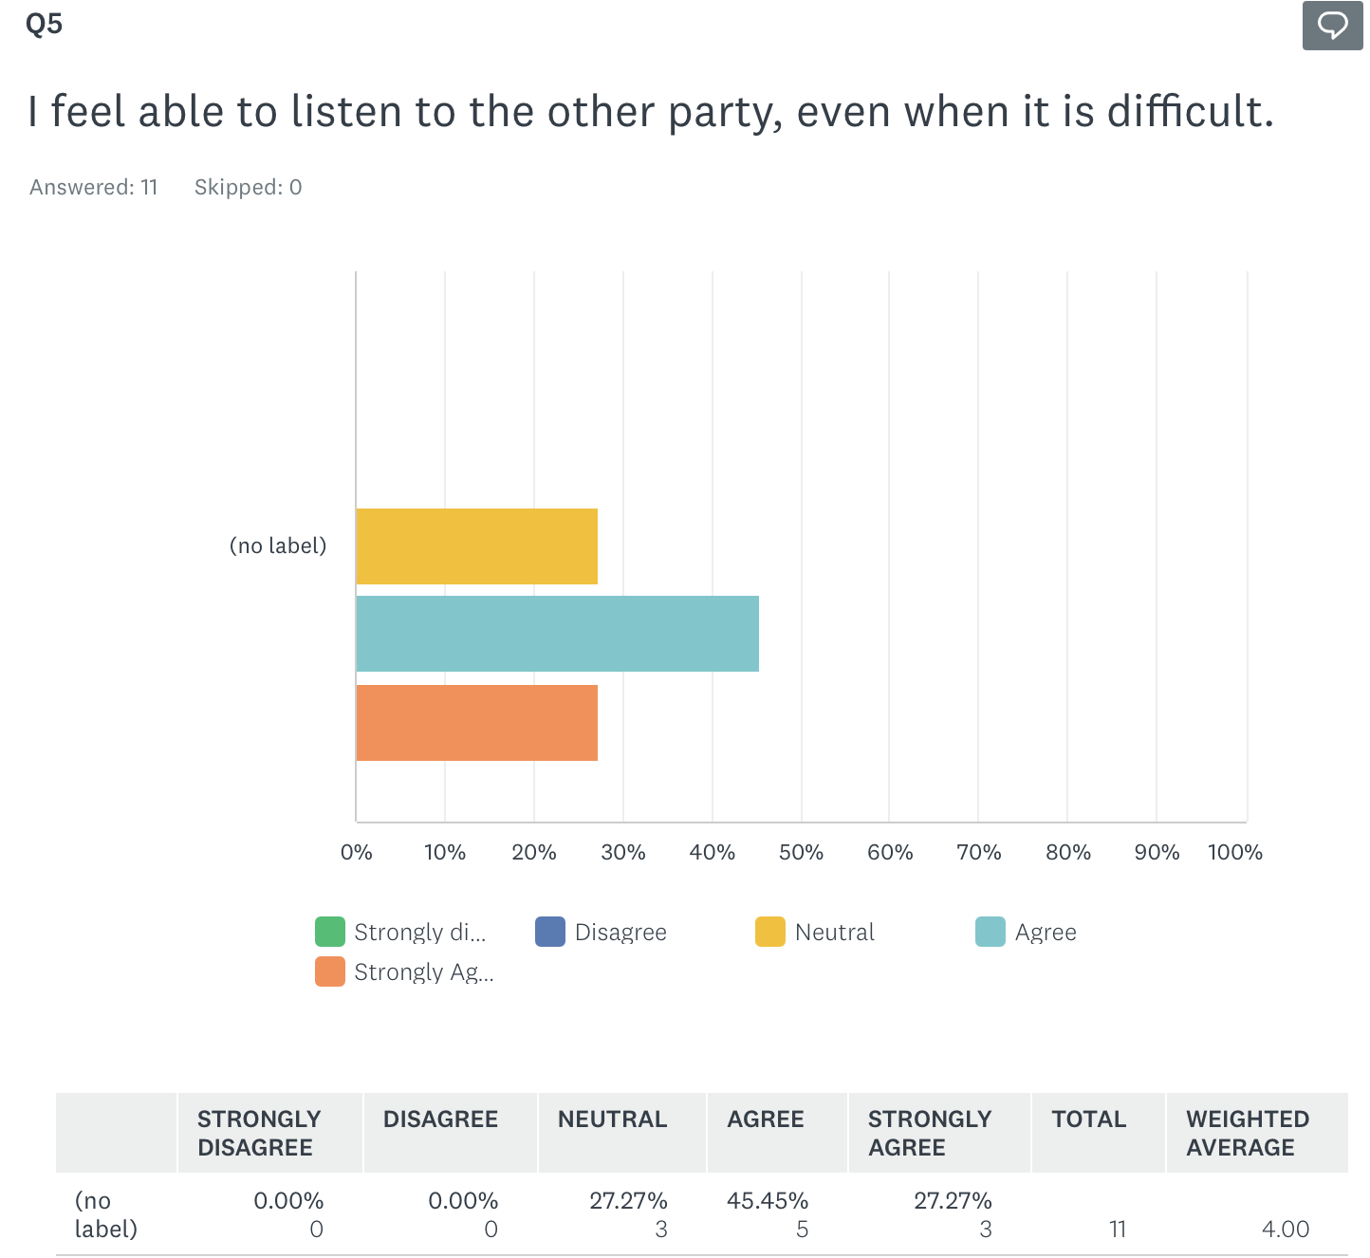
Question 5:

Slide 37
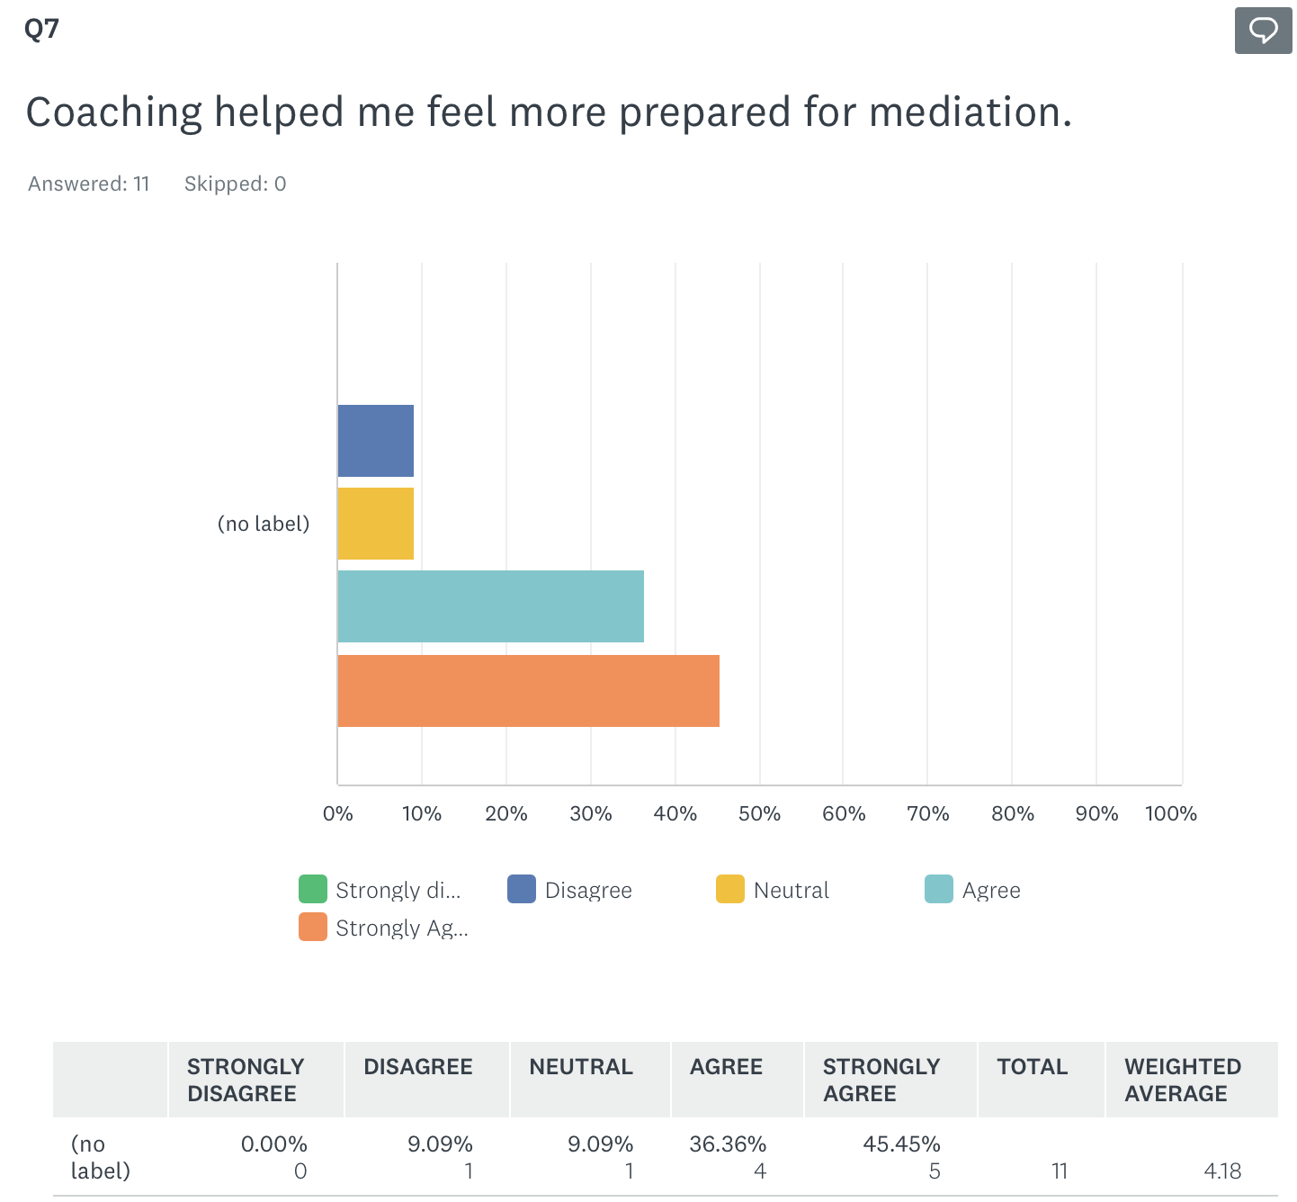
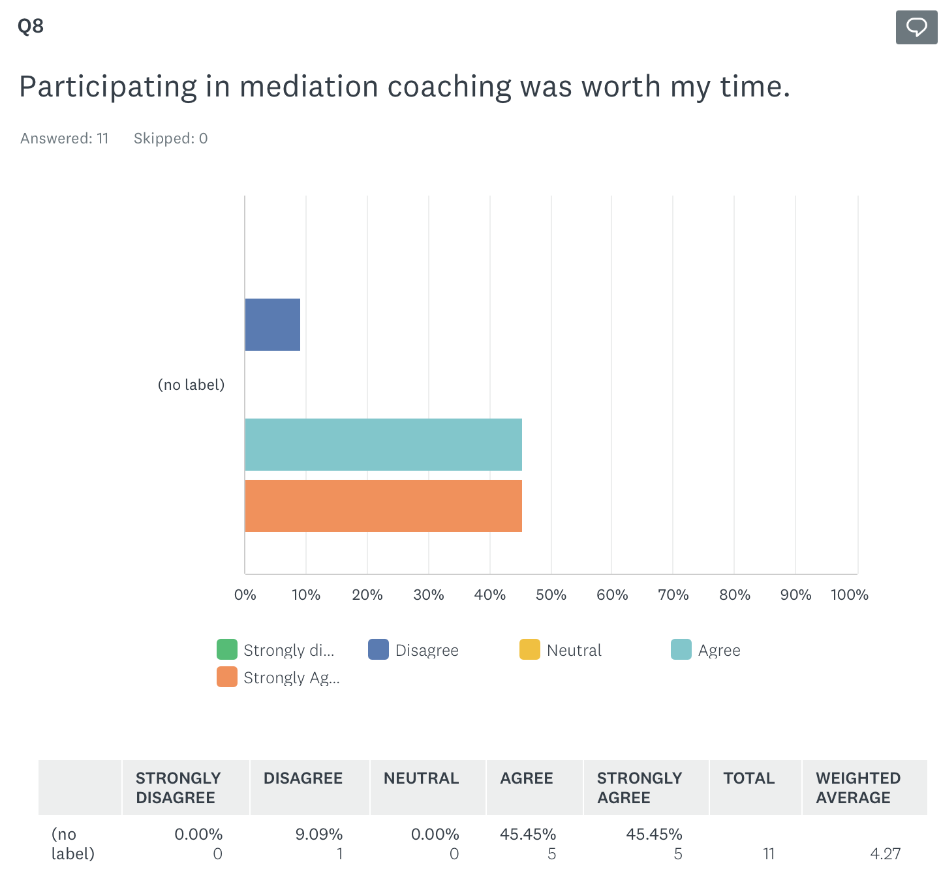
Post Coaching Perspectives

Slide 38
Qualitative Questions:
What concerns or questions do you have about mediation right now?
Pre-Class Survey
“Is this the right step for my situation and I feel unsure of how my ex wife will respond to it.”
“How it all goes down and will everything get resolved”
“My other parent is a liar. I am not the best communicator when the subject isn’t based in truth. It frustrates me, but I want to complete the process and come to a resolution”
“How to get mother involved without drama”

Slide 39
Qualitative Questions:
What concerns or questions do you have about mediation right now?
Post-Class Survey
“I am still concerned with how my ex wife may view this proposal but I do believe if she was to take this class it would benefit us both going forward.”
“No new questions or concerns Great perspective on a few topics”
“What type of say does the GAL have in mediation”
“I still don’t have a plan for moving past blatant fallacies in a conversation.”
“Other partner being combative and mean”
“is it sliding scale”

Slide 40
Qualitative Questions:
Is there anything else you would like to share about your coaching experience?
Post-Class Survey
“I feel much more confident with the process and this is a great resource.”
“The reminder about BATNA etc was perfect I think about but don't always use it well”
“very informative”

Slide 41
Qualitative Questions:
One thing that feels clearer or more manageable after coaching is:
Post-Class Survey
“using mindfulness.”
“It isn’t legally binding
“What to bring with me”
“communicating”
“Is it a communication problem or court problem”
“Communication and give to get”

Slide 42
Readiness Continuum
Are you ready to mediate?
Not Ready
Ready

Slide 43

Individual
Pre-Mediation Coaching
Free one-on-one pre-mediation coaching session with Andrea Keeling
coaching@marchmediation.org
  Further preparation
  Not therapy
  Not legal advice

Slide 44




Slide 45
Pre-Mediation Coaching Resources
Bill Eddy-
New Ways for Families®: Pre-Mediation Coaching Manual
New Ways for Families® Pre-Mediation Coaching Workbook (PDF Fillable version)

Slide 46

Thank you for attending!

